Slide 1
Deep Convolutional Neural Network (DCNN)
Vivek Singh
Reference: (Gulli and Pal) Deep Learning with Keras, Chapter 3.

Slide 2
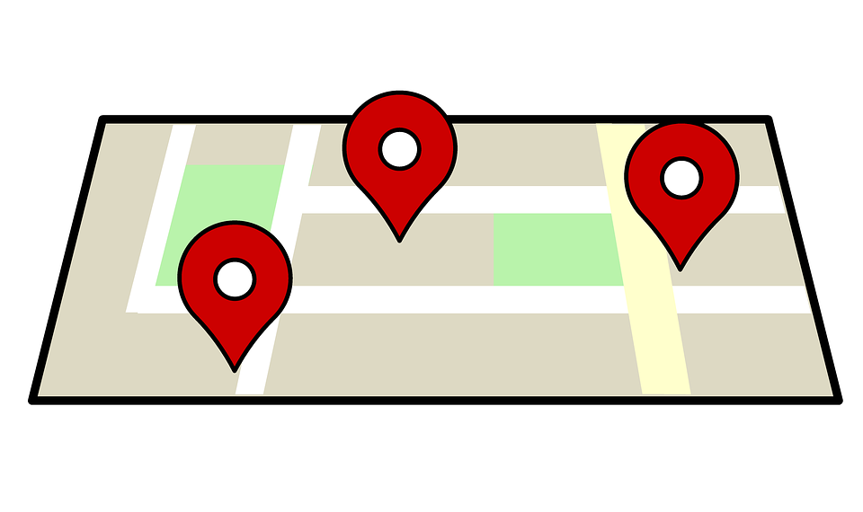
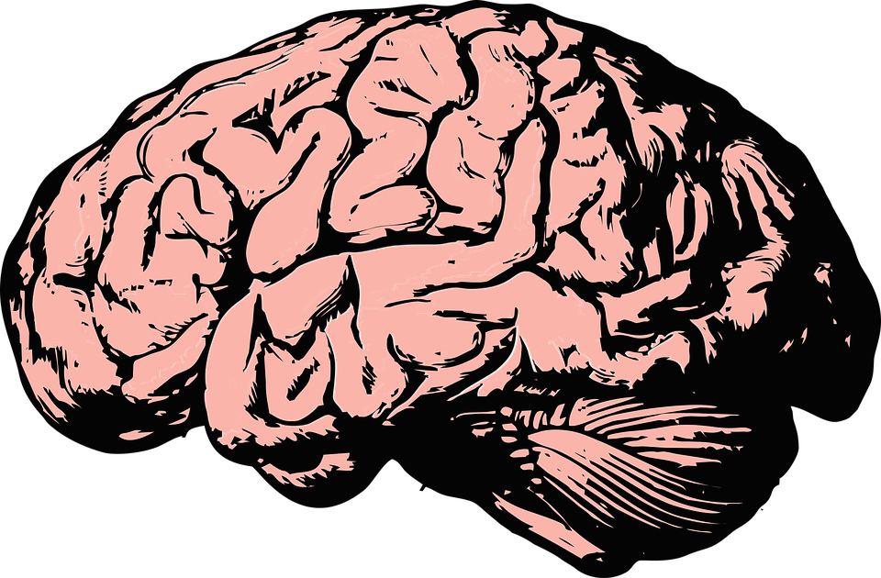
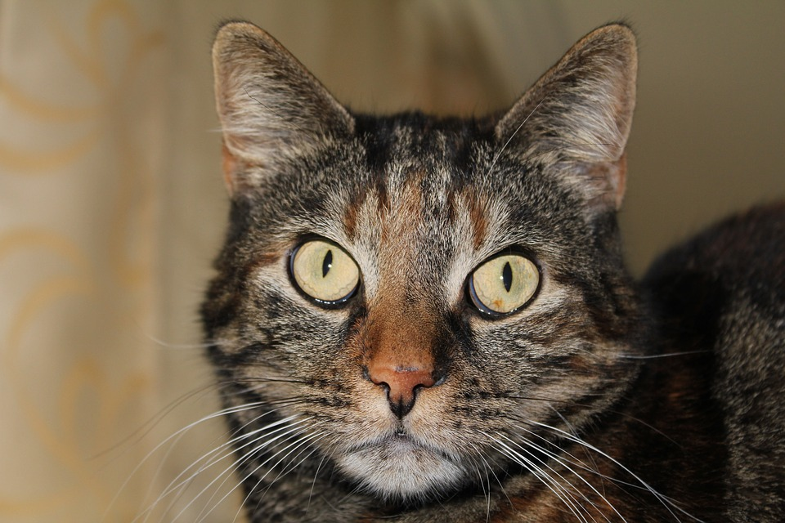
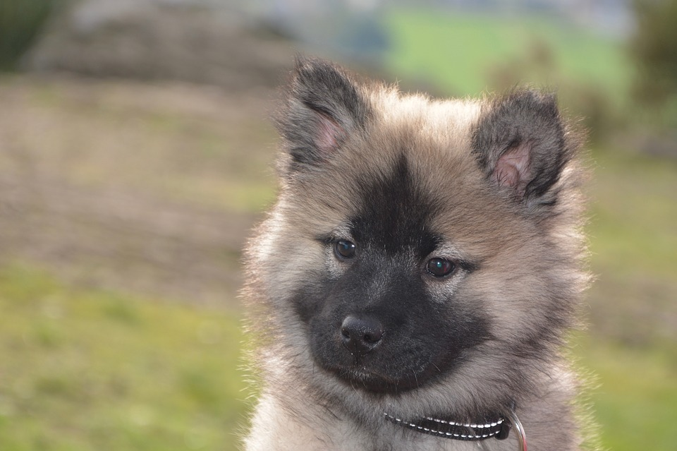
Convolutional Layer
Fully connected or dense layer does not include relation among the surrounding pixels.
Well suited for classifying images.
The network resembles ‘visual cortex’ in brain.
Not limited to images but also applied to text, video, and speech.
vs.

Slide 3
Deep convolutional neural network (DCNN)
Multiple layers of convolutional layer, activation, pooling, etc.
Convolutional and pooling layers are alternated.
The last stage of sequential model is made up of one or more fully connected layers.
Lets discuss MNIST database images for illustration

Slide 4
MNIST image (Handwritten digits 0-9)
10
9
Number of 10 by 10 submatrix which can be
generated by shifting it one unit either to right
or down = (N-n+1) time (N-n+1)=
(28 -10+1) times (28-10+1) = 19 * 19
Each submatrix is represented by one neuron in the
convolutional layer.
28
28
In Keras, size of each single submatrix is called stride length which can be changed by the programmer.

Slide 5
Performance variation over different dimensions
Number of layers
Stride length

Slide 6
Pooling layers
8 | 10 | 2 | 4
1 | 5 | 6 | 15
6 | 2 | 11 | 13
1 | 4 | 12 | 1
10 | 15
6 | 13
Max pooling
8 | 10 | 2 | 4
1 | 5 | 6 | 15
6 | 2 | 11 | 13
1 | 4 | 12 | 1
Average pooling
6 | 6.75
3.25 | 9.25
List of different pooling operations in Keras: https://keras.io/layers/pooling

Slide 7
Apply DCNN to different data types
Images – We already discussed.
Text and audio – Convolution and pooling layers in one dimension.
Video – Convolution and pooling layers in three dimensions ( height * width * time)

Slide 8
Prominent researchers in CNN
Yann LeCun: https://www.linkedin.com/in/yann-lecun-0b999/

Slide 9
Other resources
Video on CNN, CS231n: https://www.youtube.com/watch?v=AQirPKrAyDg

